Slide 1
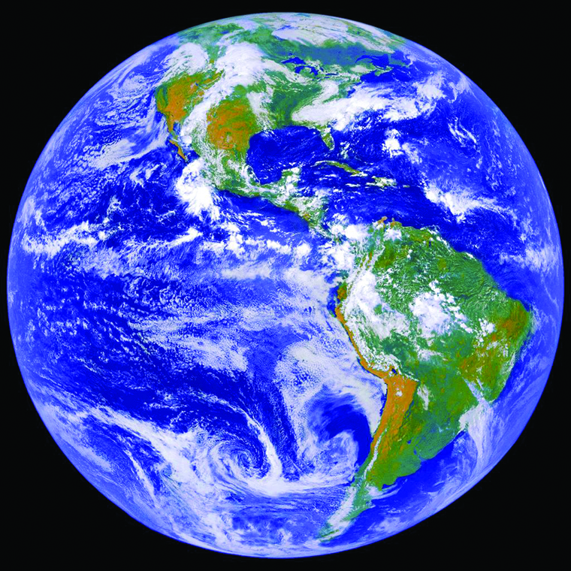

Year 1962
World Population
Population: 1.2 3.4 3.6 3.8
(billion)
Growth (%): 2.2 1.4 -0.1 1.2
2010
1950
1995
1965
Population estimates
United Nations
Maddison 2010
Maddison 2008
US ‘consensus’
Population growth (%)
+ -
1980

